Slide 1

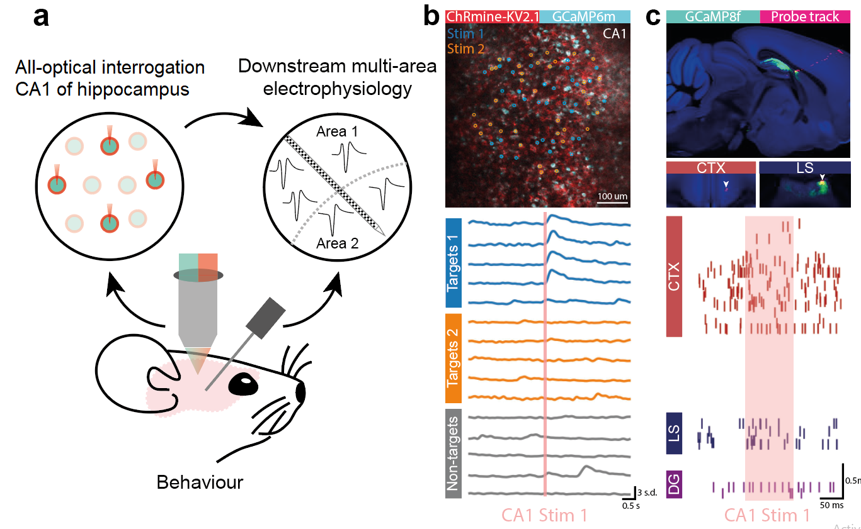
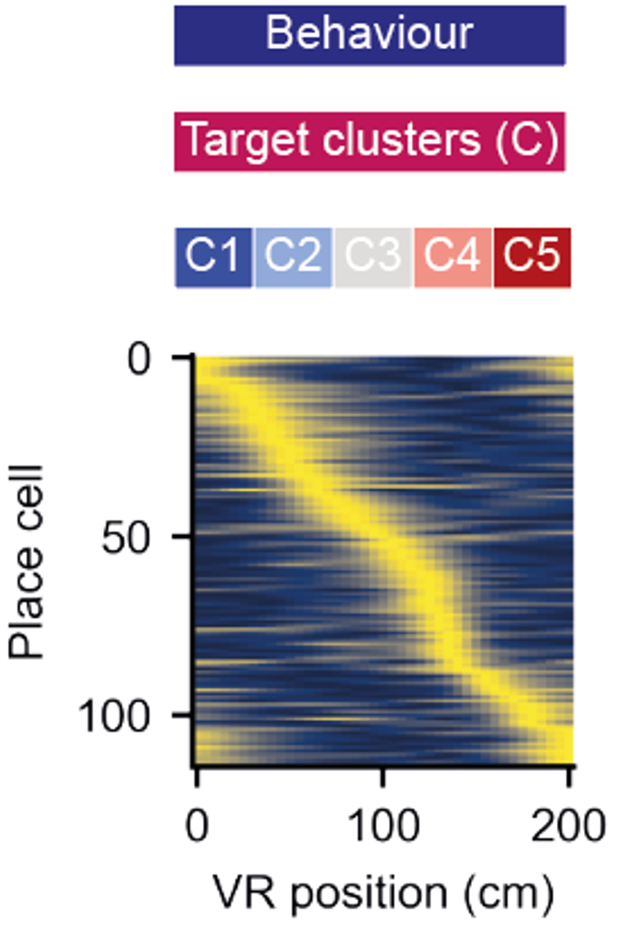
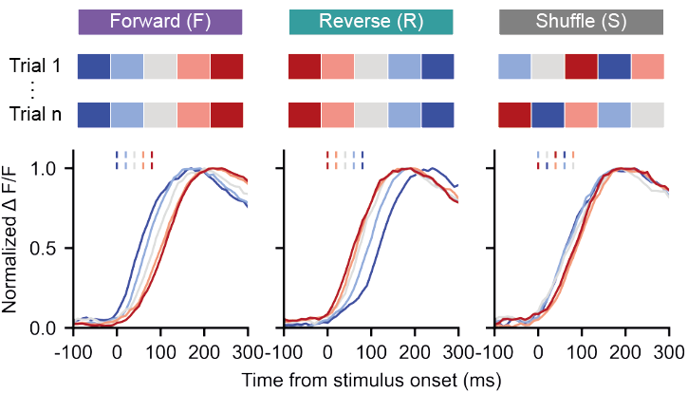
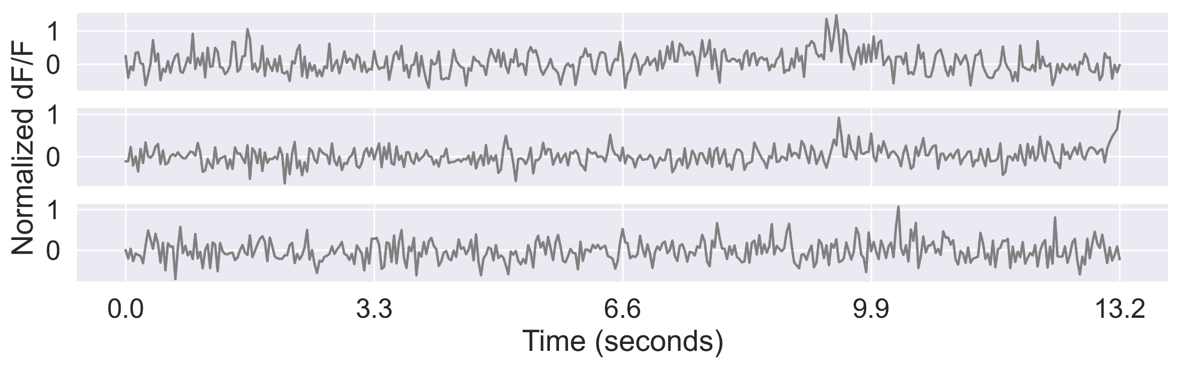
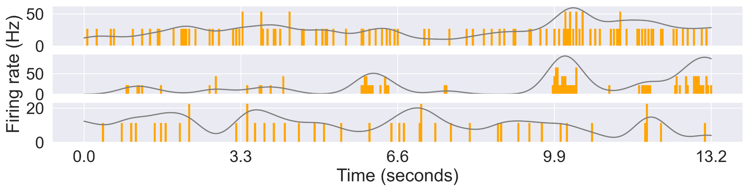
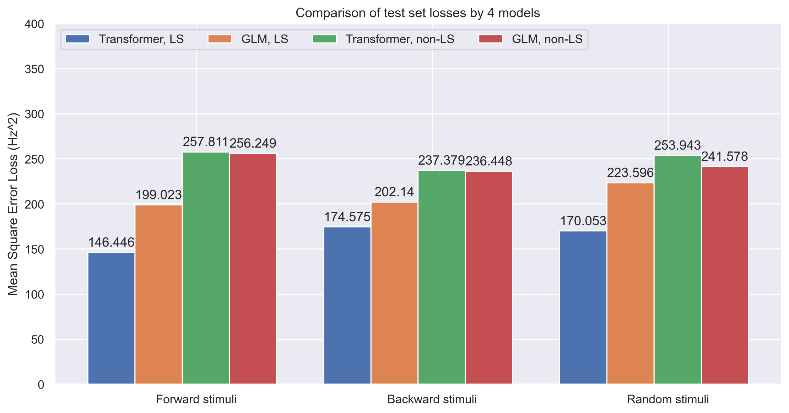
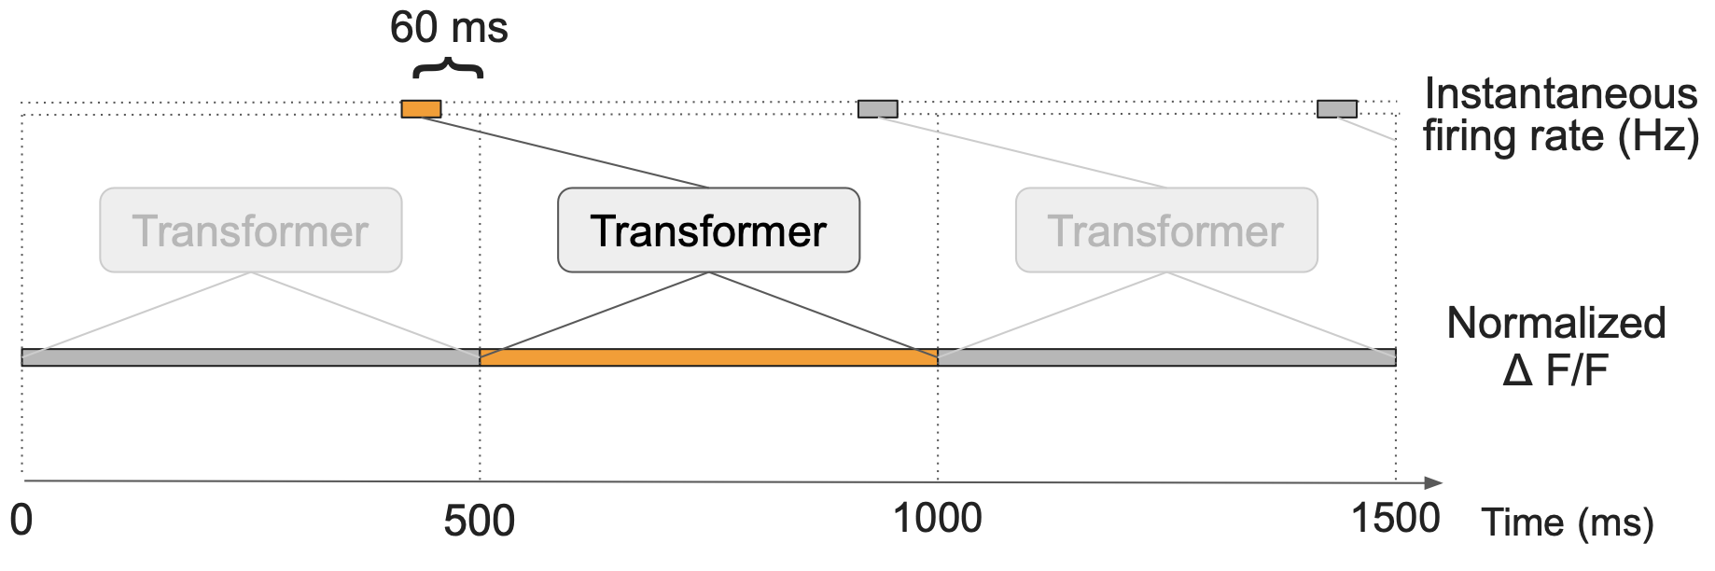
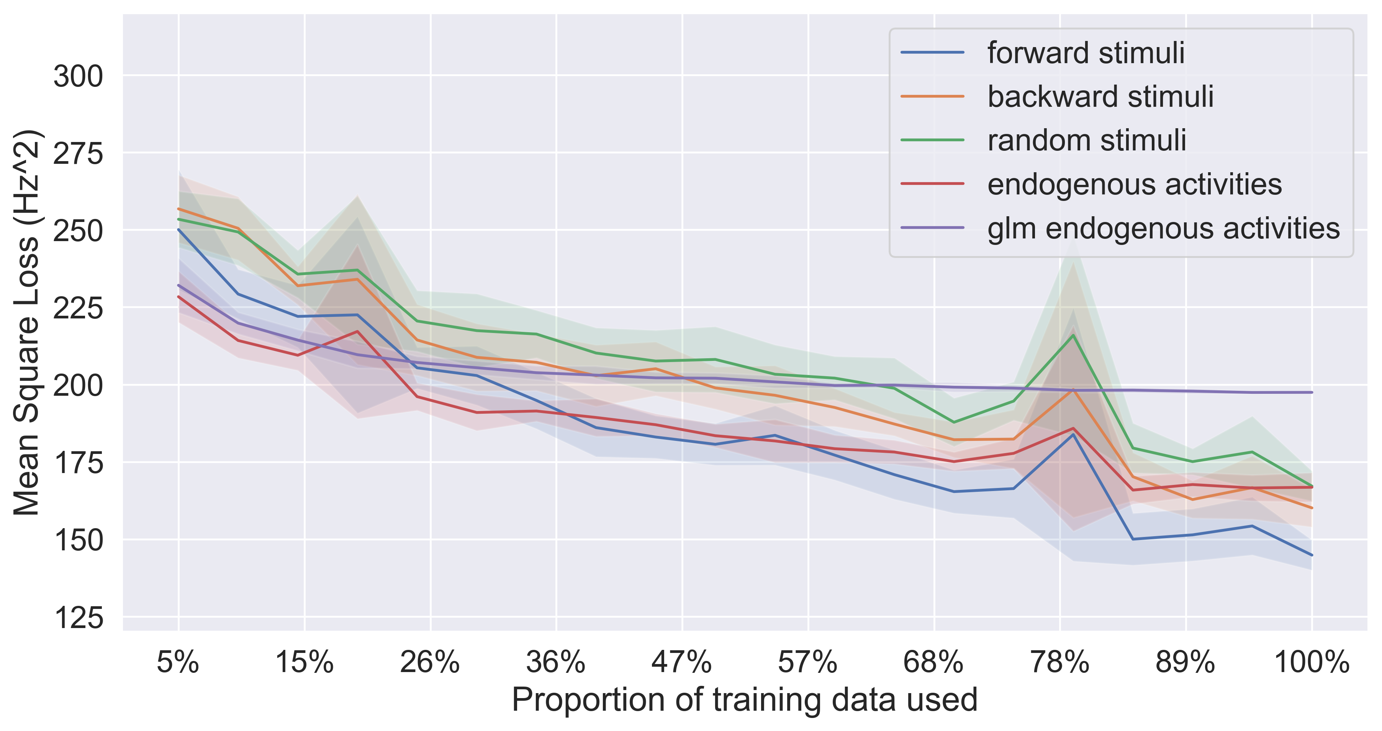
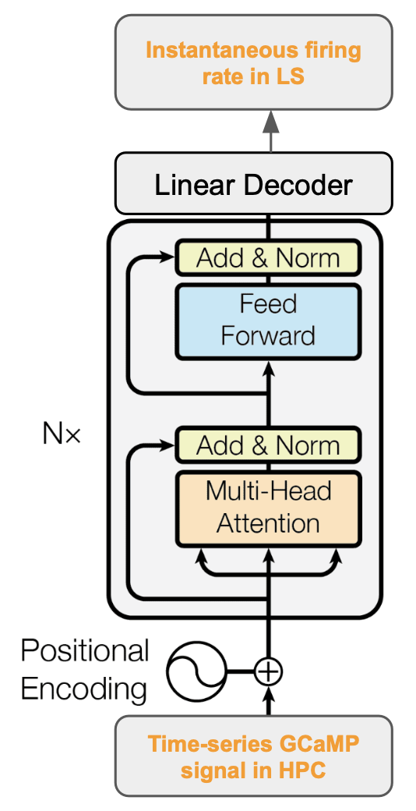
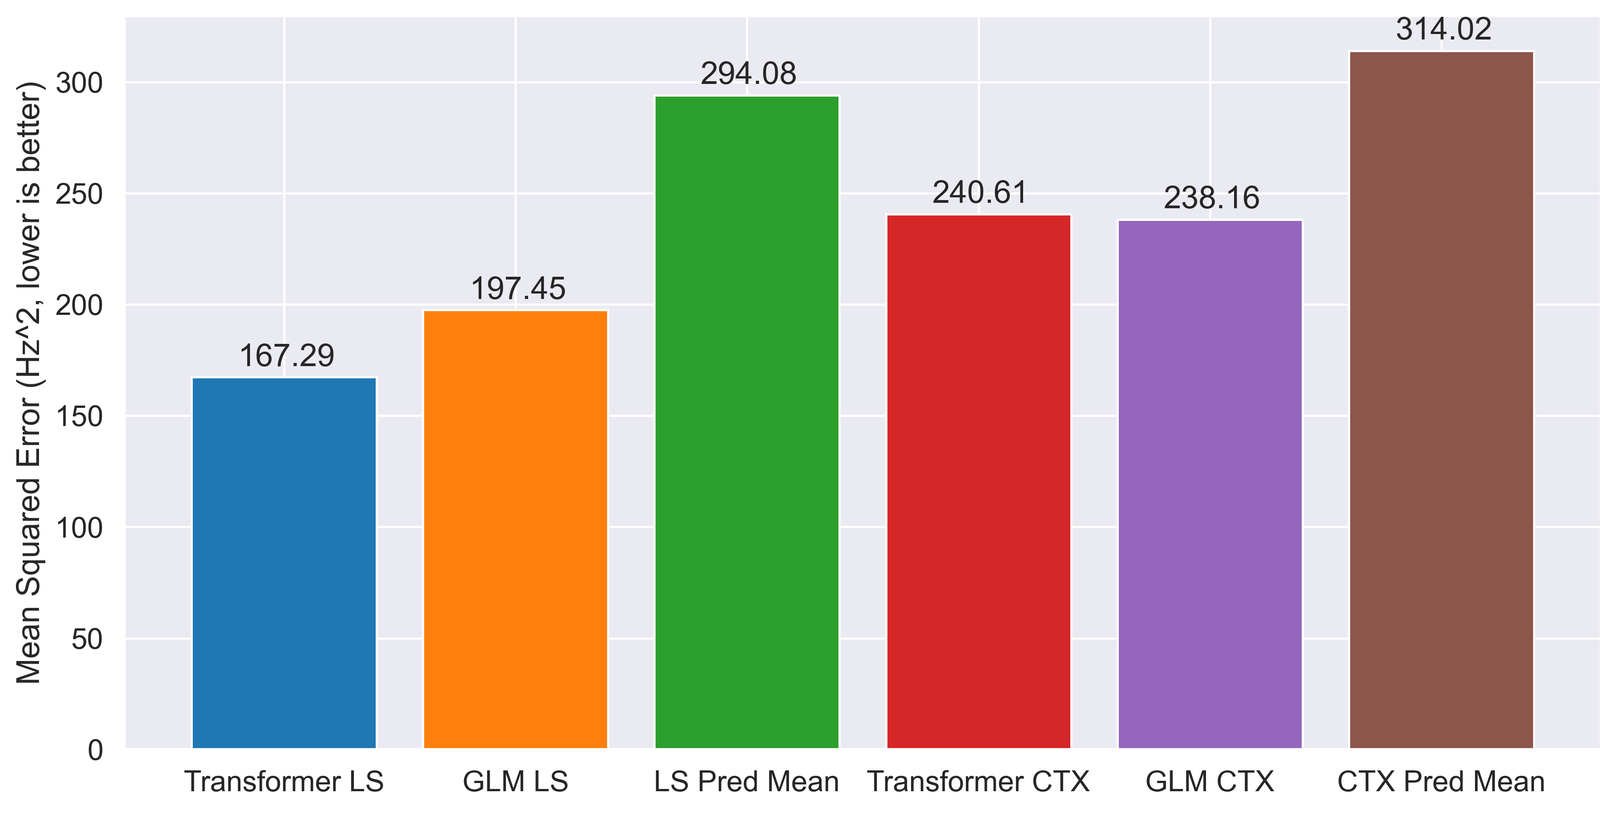
Transformer Learns Neural Circuit with Diverse Stimulation Patterns
S. Liu^{1*}; A. Mavor-Parker^{2,3*}; E. Baumler; M. Buchholz & C.Barry¹
¹ UCL Dept of Cell & Developmental Biology. ² UCL Inst yyy. ³ UCL Inst of xxx. * Equal contribution. Correspondence to first.author@ucl.ac.uk or caswell.barry@ucl.ac.uk
Introduction. To understand the brain, we need to understand the computations performed by neural circuits. One approach is to use observed data to distil the neural function into artificial neural networks. This requires access to neural data from the input and output neurons of a neural circuit.
We performed simultaneous neural recording from the CA1 area of the hippocampus as well as the lateral septum (LS) and cortical areas (CTX). We then trained sets of transformer neural network models on the CA1 – LS circuit. The trained models demonstrated competitive accuracy and efficiency compared to baseline GLMs, and are able to generalise when random stimuli are injected optically into the input neurons.
Simultaneous neural recordings
Light-activated stimuli injection
We simultaneously recorded fluorescence signals in hippocampus CA1 as well as multi-unit spiking activities in the LS and CTX.
387 CA1 neurons were interrogated via GCaMP, 77 neurons were recorded via Neuropixel probes, of which 13 were identified from LS.
All-optical simulation allows us to manually inject stimuli to CA1 neurons by light. To test how well a trained transformer model can generalise predictions to non-endogenous activities, we injected three types of stimuli: forward, reverse and random. (Needs more explanation here)
CA1
HPC 7
HPC 126
HPC 268
CTX 15
CTX 67
LS 3
With activities arising from all three stimulation schemes, transformer predicted significantly better in the CA1 – LS circuit.
Transformer learns endogenous activities
Leveraging the power of transformer neural networks, we use 15 bins (500 ms) of CA1 fluorescence signals to predict 1 bin of LS and CTX neuron firing rates. Because of the exponential decay time of fluorescence signal, the optimal offset was found to be -60 ms using a GLM.
Data efficiency
We tested the performance of the transformer model trained on smaller proportions of the available endogenous activities.
We trained two transformer models, using 43 mins of CA1 activities to predict LS (where direct projections exist) and CTX (where no direct projections exist) endogenous activities, respectively.
The transformer features multi-head attention which was used in natural languages, can selectively focus on activities features in the CA1 neurons with positional information, and allows parallel processing.
Transformer outperforms GLM at every data point, whereas GLM flattens out due to its predictive power.
Conclusions
Optical and electrophysiology recording data enables computational modelling of the hippocampal CA1 – lateral septum circuit in mice.
Transformer neural networks can be trained on endogenous activities to learn the functional mapping of this circuit.
Trained model generalises to neural activities where light-activated stimuli is injected externally.
Transformer outperforms baseline models in all scenarios.
Training transformer is time saving and data efficient, and continues to improve when more data is provided.
The trained transformer predicts the CA1 – LS circuit 15% better than a baseline generalised linear model and 43% better than predicting the mean alone, under the mean squared error metric. Training the transformer is also more data and compute efficient (see conclusion).
^{References}

